Slide 1
A secure, scalable, FOTA-capable, home automation IoT system to control fan and air-conditioner electronics
Featuring MQTT protocol, MicroPython and Node-red
1751119
Nguyen Thanh Tung

Slide 2
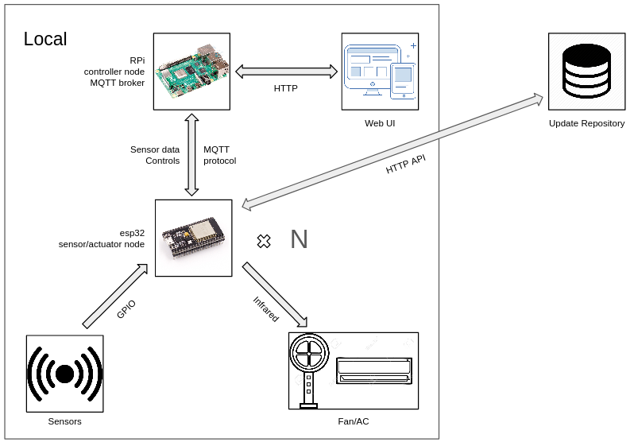
Introduction
Overview
An IoT application that deals with
Automation
Scalability
Networking
Security
Updatability (FOTA)
An IoT application that is based on Consumer Infrared (CIR) technology, that is
Non-intrusive
Has control feedback mechanism
IoT hardware
Automation
Scalability
Networking
Security
Updatability (FOTA)
The IoT system topology

Slide 3
Contents
IoT design
Automation
Scalability
Networking
Security
Updatability
Web UI
Summary

Slide 4

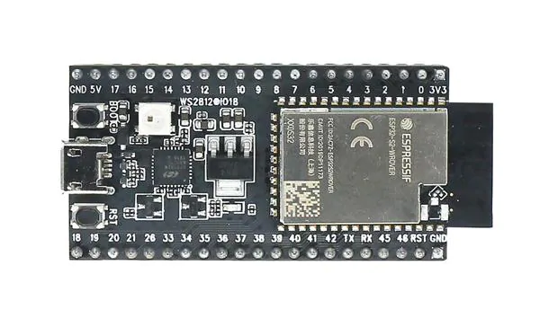

IoT design essentials IoT Design
The IoT service on esp32 is programmed in MicroPython, a port of Python
There are GPIO pins on the esp32
Binary value can be read from or driven to a GPIO pin
Connect to external hardware sensor and actuator modules
Most sensor and actuator modules have a simple data interface
Logic 1 represents the ON state
Logic 0 represents the OFF state
Each sensor or actuator module typically requires a power and ground connection
Power (high voltage) drives every logic 1 (pull-up network)
Ground (low voltage) drives every logic 0 (pull-down network)
1
OUT
0

Slide 5
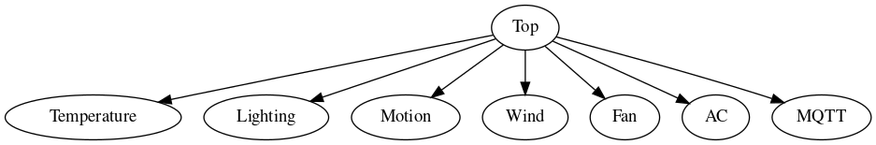
Top module IoT Design
One top module that initializes many submodules
Every module has 3 methods
start
stop
routine
Every module operates at a specific clock
The routine method is called at every clock cycle
Scheduled callback is through the timer class API
2 modes
ONE_SHOT
PERIODIC
init
deinit
There is a master clock where all other clocks are derived from
MQTT module handles sending sensor data and receiving commands
Upstream is the data interface between the MQTT module and another module
Downstream is the data interface between a module and a hardware sensor/actuator
The IoT service module hierarchy
Master clock | 20
Temperature | 2020
Lighting | 380
Motion | N/A
Wind | 20
Fan | 580
AC | 620
MQTT | 460
MQTT module
upstream
Typical module
downstream
Sensor/actuator
Each clock period is a prime number
Motion module does not have a clock
Operate on GPIO edge-triggered interrupt
The clock period of each module in unit of microsecond

Slide 6
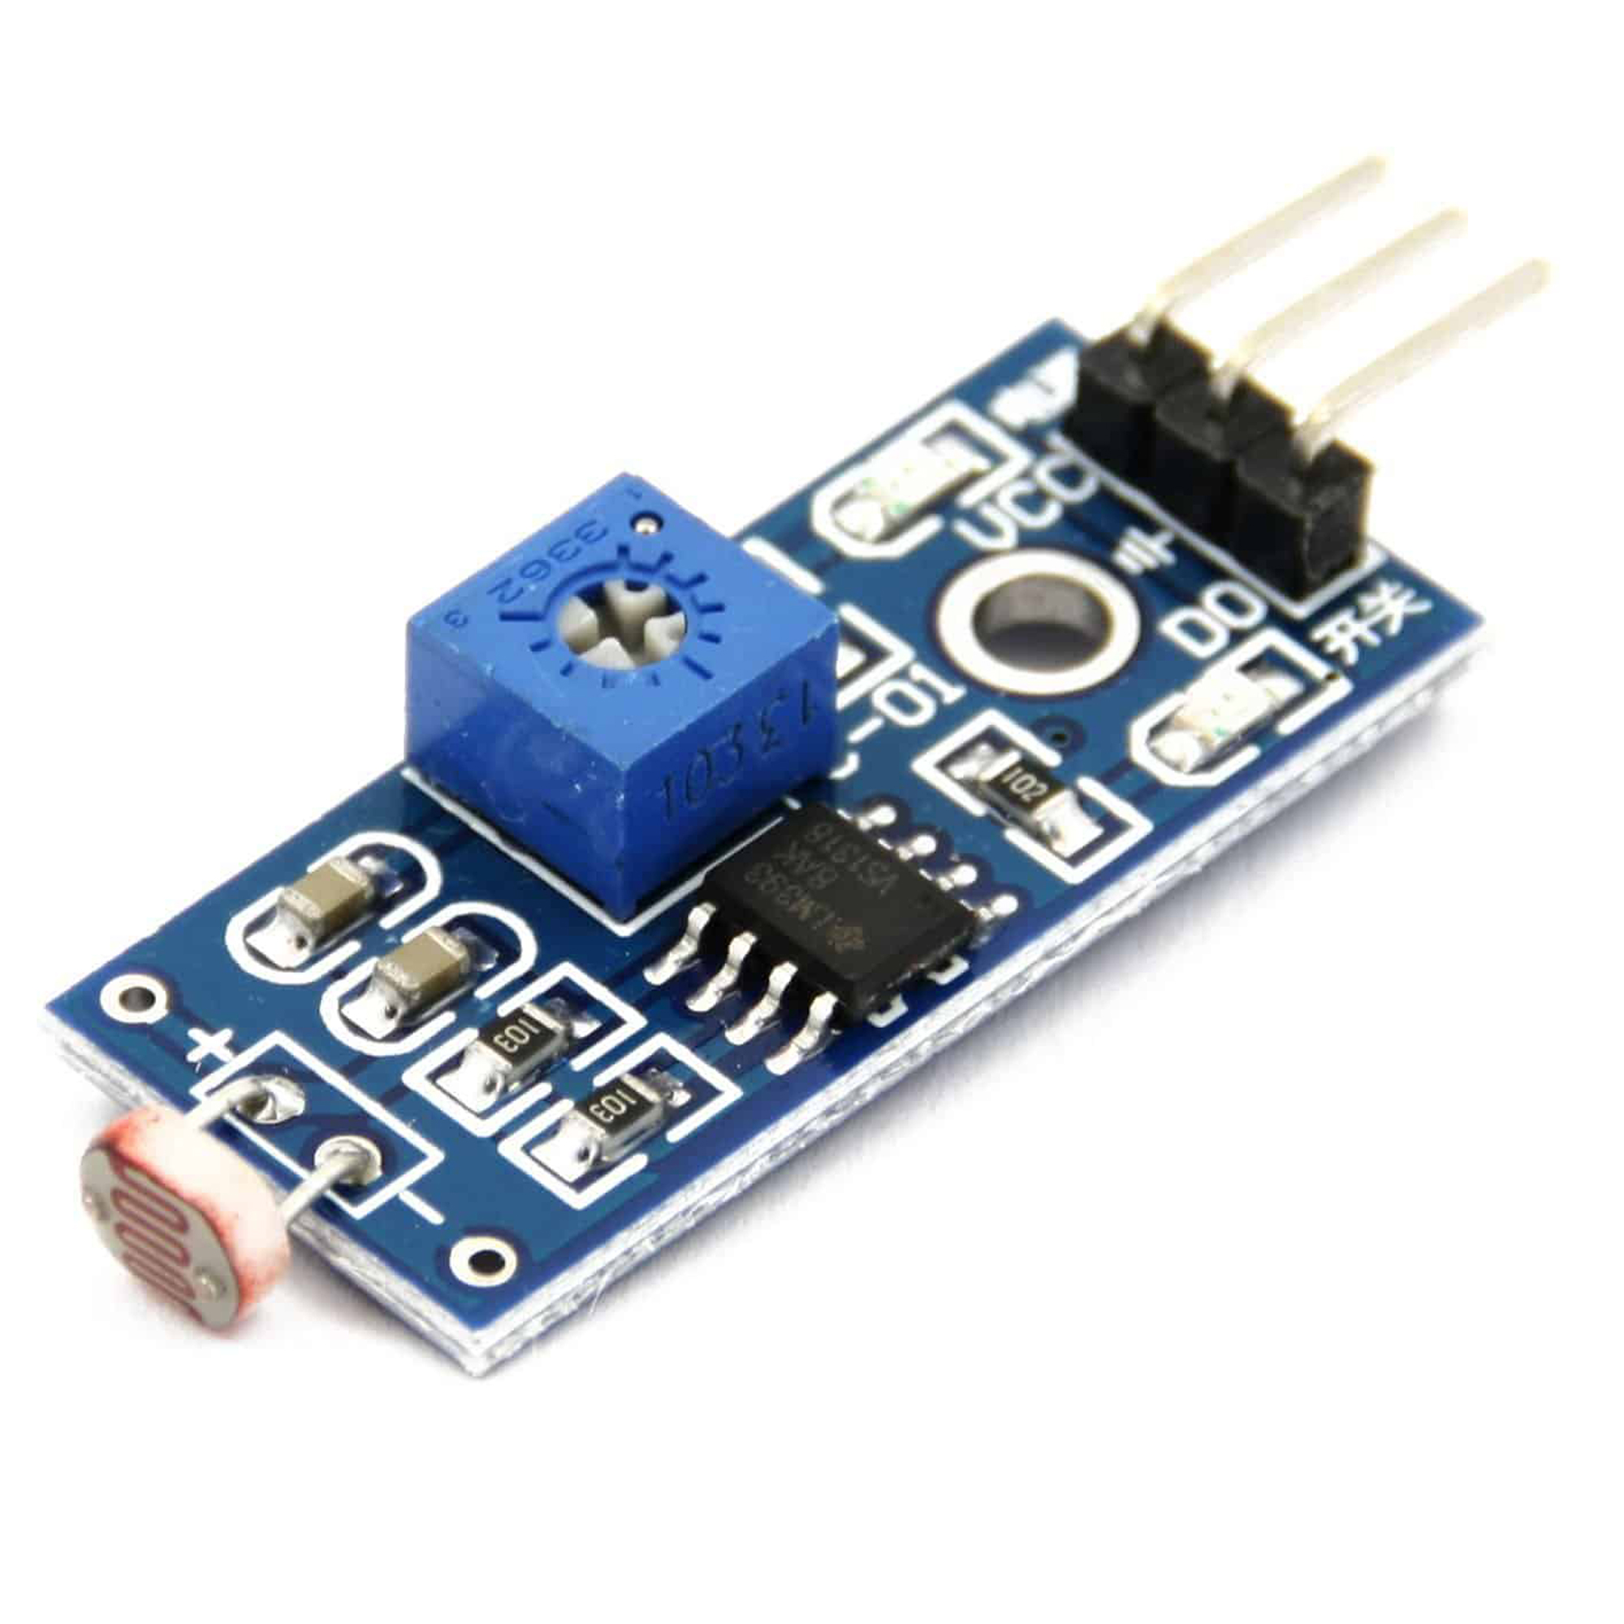
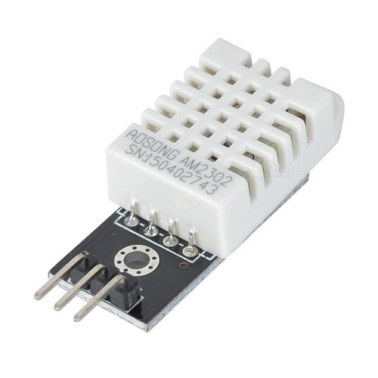
Temperature module IoT Design
Lighting module IoT Design
DHT22 sensor
I2C bus protocol
Temperate and humidity can be read through a built-in DHT22 class
Data read should be spaces at least 2 minutes apart for best precision
Operating clock period is 2020 ms (101 times the master clock)
CDS - NVZ1 sensor
Output active low signal
Operating clock period is 380 ms (19 times the master clock )
DHT22 sensor
CDS - NVZ1 sensor

Slide 7
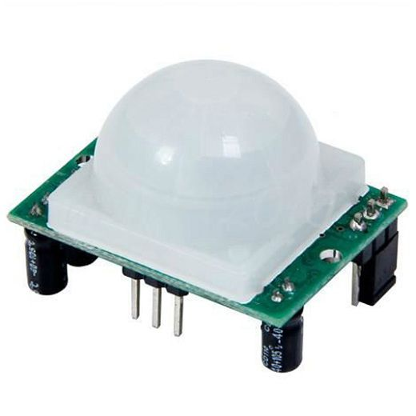
Motion module IoT Design
PIR HC-SR501 sensor
Output is held at logic 0 while motion is NOT detected
Output alternates between 3s of logic high and 3s of logic low while motion IS detected
The motion module should output
0 when motion is NOT detected
1 when motion IS detected
Handling logic
Operate at GPIO pin edge-triggered interrupt
At the pin transition from logic 1 to logic 0, init timer to output 0 in 3 seconds
At the pin transition from logic 0 to logic 1, deinit timer and output 1 immediately
PIR HC-SR501 sensor
Timeline
3
6
9
12
15
18
21
24
(s)
Downstream
Upstream

Slide 8
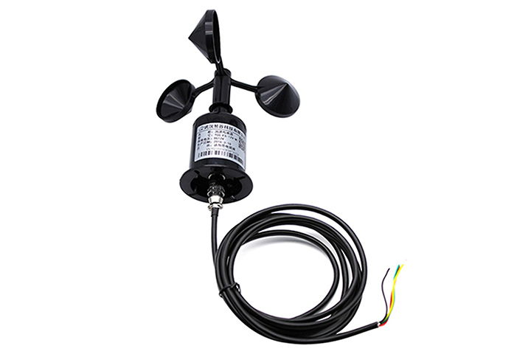

Wind module IoT Design
The wind module needs to
Output 1 when and only when the fan is ON
Avoid false trigger
Handling logic
Initially output 0
Fan ON → sensor starts toggling between logic 0 and 1
A clock cycle is called filled if any toggling happens in that cycle
Once enough cycles are filled consecutively, change the output to 1
Fan OFF → the toggling slowly comes to a halt
Once a single cycle is empty, immediately change the output back to 0
A latency of 7 seconds
YJ-FS RS232/RS285/TTL sensor
Output constantly toggles between logic 0 and logic 1 when wind is detected
Operating clock period is 20 ms (equal to master clock)
The module that decides the master clock period
YJ-FS RS232/RS285/TTL sensor
OUT
0
1
7s
7s
Downstream
Upstream

Slide 9
Fan module IoT Design
Handle turning the fan ON/OFF
Receive fan current state from the wind module
Expose a fan desired state variable to be set
Handling logic
Maintain a busy flag
When not busy, compare current state to desired state
If equal → does nothing
If NOT equal
Transmit ON/OFF signal
Go busy for 7 seconds
The loop repeats
Control feedback mechanism to guarantee the desired state will eventually be attained

Slide 10
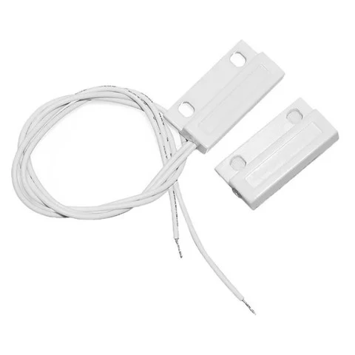
AC module IoT Design
Receive AC current state from a simple magnetic door switch sensor
Same handling logic as the fan module
Magnetic door switch sensor
7s
7s
Timeline
Desired State
Current State

Slide 11
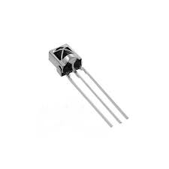
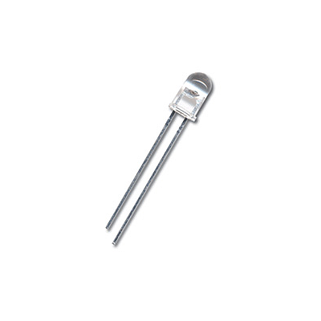
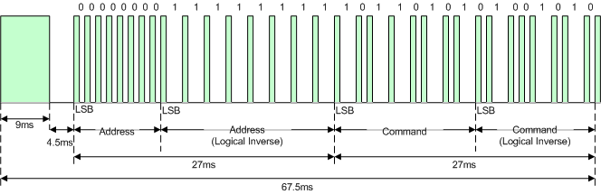
Infrared design IoT Design
Capture IR command using IR transmitter and receiver LEDs
The receiver LED outputs binary pulses when IR signal is captured
NEC protocol
Pulse width modulation
Leading pulses
Encoded command
Inverse of command
Stopping pulses
Transmitter LED can be driven by switching the GPIO pin connected to the LED
Let the RMT class does the switching with extremely high precision
RMT takes as parameter
Clock rate
Normalized timing array
IR carrier frequency
TSOP1838 IR receiver
Generic IR transmitter LED
To successfully transmit an IR command
The pulse width info has to be learnt
The command code has to be learnt
Use GPIO pin edge-triggered callback to capture timing info into a timing array
The callback routine has to be small and short
Pulse width info has to be approximated from statistical sampling
Command code can be retrieved from timing array and verified by the its inverse
NEC protocol encoding

Slide 12
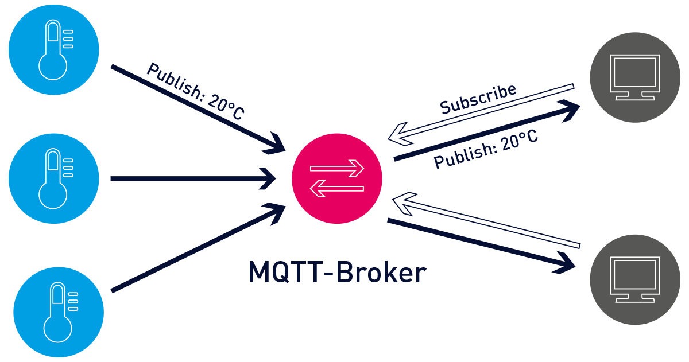
MQTT essentials IoT Design
“The MQTT protocol defines two types of network entities: a message broker and a number of clients. An MQTT broker is a server that receives all messages from the clients and then routes the messages to the appropriate destination clients. An MQTT client is any device (from a micro controller up to a fully-fledged server) that runs an MQTT library and connects to an MQTT broker over a network.
Information is organized in a hierarchy of topics. When a publisher has a new item of data to distribute, it sends a control message with the data to the connected broker. The broker then distributes the information to any clients that have subscribed to that topic. The publisher does not need to have any data on the number or locations of subscribers, and subscribers, in turn, do not have to be configured with any data about the publishers.”
MQTT illustration

Slide 13
MQTT module IoT Design
Connection establishment
Connect message
Client ID
User ID and password
Specify keep-alive period
Specify last-will message
Topic subscription
Subscribe message
Connection teardown
Disconnect message
Provide a publish method for each other module to publish sensor data to sensor topics
The routine function
Ping MQTT broker to avoid timeout
Check socket (non-blocking) for messages from control topics
Available control commands
Set fan desired state
Set AC desired state
Perform FOTA update
Reset

Slide 14

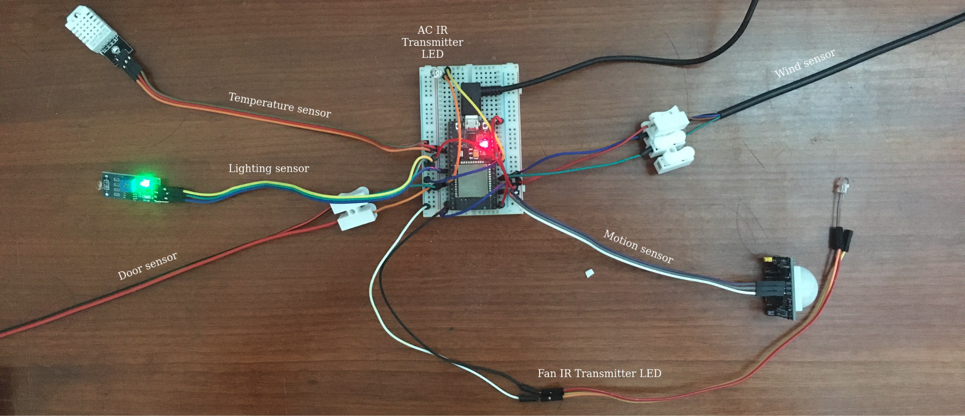
Routing IoT Design
Constraints
A power connection can be shared by at most 2 hardware modules
There is one 5V pin and one 3.3V pin to be shared among 4 hardware modules
5V gives better precision than 3.3V
Routing schematic

Slide 15
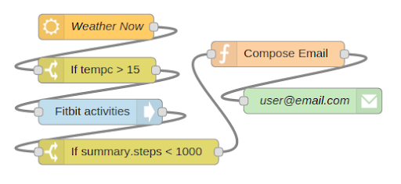
Node-red overview Automation
Flow-based visual programming tool
A Node-red flow contains nodes, which
Have inputs
Have outputs
Linked together
When input arrives, a node
Perform function on input
Send data to output
Trigger the next node
There are many types of built-in nodes
There is the function node for scripting in Javascript
Custom nodes can also be built
A separate web UI for the end-user can also be built
An example Node-red flow

Slide 16
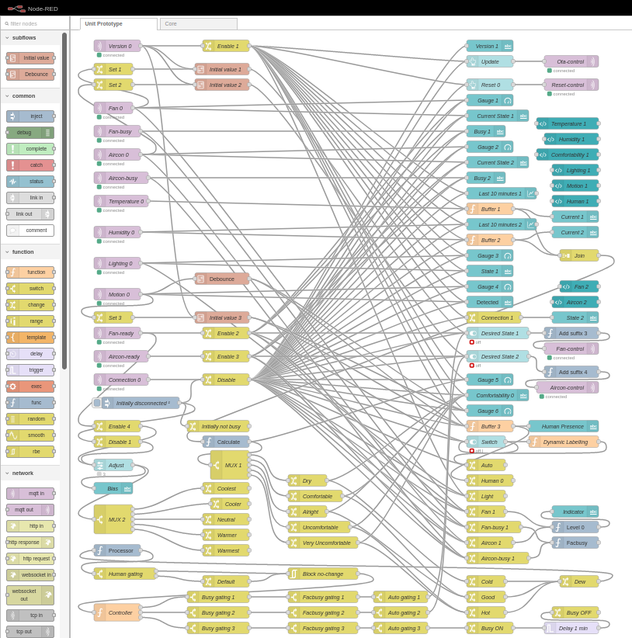
Design overview Automation
Our Node-red design contains 4 general classes of node
MQTT endpoint nodes
Automatic control rules nodes
Enable/disable controller nodes
End-user UI nodes
Next is a capture of the whole RPi automation controller flow

Slide 17
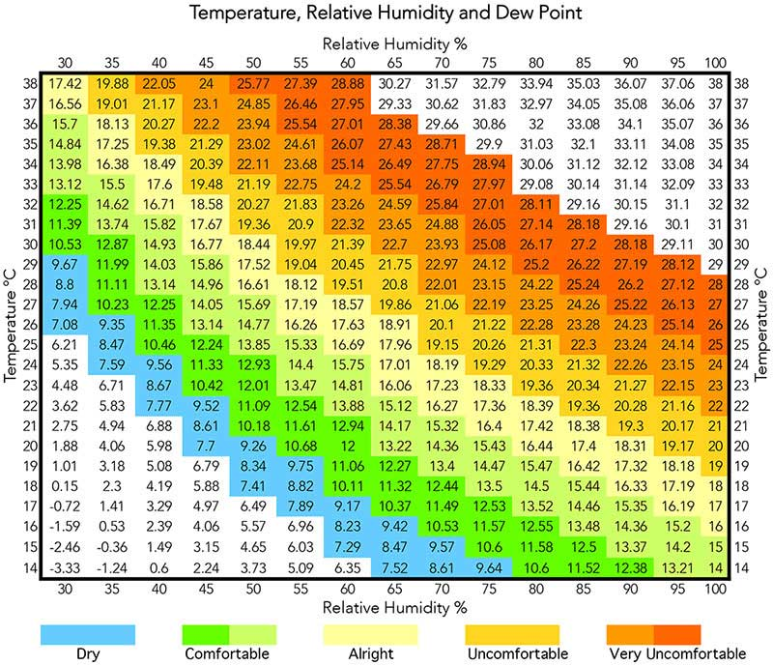
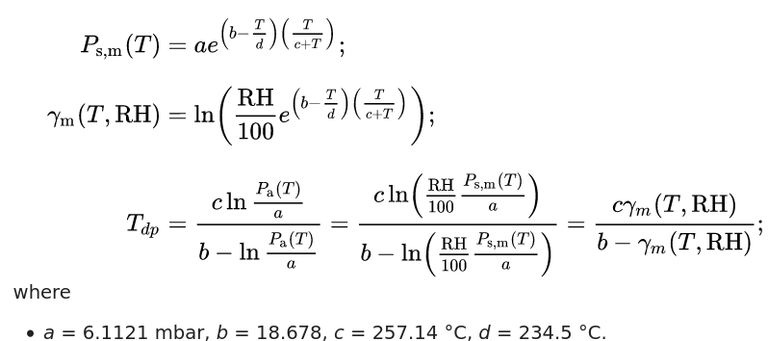
Heuristic selection Automation
Temperature and humidity together affect how comfortable the air feels
The dew point temperature can be computed using a formula
Comfort level heuristic can be derived from the dew point value
According to the reference chart
Dew point < 10: Dry
10 ≤ Dew point < 16: Comfortable
16 ≤ Dew point < 19: Alright
19 ≤ Dew point < 22: Uncomfortable
Dew point ≤ 22: Very uncomfortable
The dew point formula
Dew point and comfortability chart

Slide 18
Automatic control rules Automation
The fan and AC have 4 possible power level states
Power state is raised or lowered one level at a time to keep the comfortability heuristic in the comfortable state
After the power state is changed, it would take some time for the changes to be reflected by the DHT22 sensor
Additional rules
When human is NOT present, keep at level 0
When lighting is OFF, keep at level 0 or 2
The user can also opt for a warmer or cooler preference
Level | AC | Fan
3 | ON | ON
2 | ON | OFF
1 | OFF | ON
0 | OFF | OFF
Possible power states

Slide 19
Overview Scalability
Design Scalability
The IoT system is dynamically scalable in terms of the number of sensor/actuator nodes
One esp32 can handle many instances of esp32
When a new esp32 joins, a new UI tab automatically spawns
Each esp32 has a unique machine ID, which is also the name of the handling UI tab
An esp32 can be added
By simply plugging the power socket
Without any software configuration needed
Anywhere there is a pair of fan and AC to be put under control
The prototype that handles a prototype esp32 instance is handcrafted from earlier
The prototype flow JSON can be retrieved using HTTP API
The sed and awk GNU utilities are used to parameterize the flow JSON, which includes
Adding backslash before special escaped characters
Adding backslash at the end of every line for newline character
Parameterizing all IDs of the nodes in the flow to avoid ID conflict
Parameterizing the names of some nodes to identify each esp32 in the web UI
After that, a new core service flow is designed, which
Monitor a dedicated MQTT topic for new esp32 connections
Dynamically spawn a new flow for each esp32 using HTTP API and the parameterized flow JSON
The Node-red workspace can contain many flows, all active at the same time
Each node in the workspace must have a unique node ID
One flow should be assigned to handle one esp32 device
A Node-red flow can be imported or exported in JSON format
Node-red provide a set of HTTP API to modify the workspace
There are HTTP commands to
Get a specific flow JSON
Add a flow to the workspace
Edit or delete a flow

Slide 20
LAN configuration Networking
Constraints
The IoT system has to be functional when the home WiFi router is OFF
Internet connection is still needed to perform FOTA update
Our intention was to use only the wireless interface and no ethernet cables
Raspberry Pi has to be hotspot access point, which is
A wireless access point to other nodes
A wireless client to the home WiFi router
The single wireless network interface controller will have to alternate between two roles
Reduced bandwidth
It is necessary to be able to revert back to pure client network
Raspberry Pi also has to provide a DNS service
To apply TLS security, a hostname is required for the server
The subject of a TLS certificate can not be a private IP address
Guide 1
Guide 2
Systemd-networkd hotspot AP
Guide 3
dhcpcd wireless AP
dhcpcd hotspot AP with ethernet upstream
dhcpcd wireless client
Guide 4
Systemd-resolved DNS forwarder
dnsmasq DNS server

Slide 21
Edge case handling Networking
Safe operation must persist even in connection edge cases
Handling of edge cases on esp32
Exception handling for every network operation
When LAN connection is lost during normal operation
Turn off fan and AC
Stop the IoT service
Wait for connection
Restart the IoT service
Handling of edge cases on RPi
When esp32 disconnects, last-will message will be published to notify the controller node
Appropriate action will be taken and some enable/disable nodes will be active

Slide 22
Network level Security
The whole system is in a private LAN network
Hidden behind the home router NAT
Access from the WAN side is not normally possible
There are 2 ways remote access can be made possible
VPN
Through the mobile app Remote-red
VPN was not possible as the home router NAT is under more ISP NATs
Remote-red allows remote access from a mobile device to the Node-red service
After a QR code on Node-red is scanned by the mobile app
Through an initial middle server
In a P2P fashion, possibly using the network hole punching technique

Slide 23
Transport level Security
Application level Security
Inside the local network, both HTTP and MQTT protocol can utilize TLS security
There are 2 TLS entities
The local CA
The routable network hostname of the Raspberry Pi machine
Each entity is represented by its private key and public certificate
The public certificate of RPi hostname is signed by the local CA
Each client is given the public certificate of the local CA
When a client connects
The server sends its public certificate signed by local CA
The client verifies the certificate using the pre-installed certificate of the local CA
If successful, the server is authenticated
Both Node-red server and MQTT broker can enforce user authentication and authorization
Authentication requires a tuple of username and password
Node-red authorization includes restricting read/write permissions on the HTTP API and the web UI
MQTT enforce authorization according to an access control configuration file, which
Restrict certain users and clients to read/write permission on certain topics
Allow a dynamic pattern syntax that restricts a generic client ID pattern to a generic topic name
The MicroPython secure socket class does not implement CA verification yet
The solution is to
Clone the MicroPython development repository
Merge a pull request that implements CA verification into the master branch build
Rebuild and flash the new firmware
With the new firmware build, CA verification is now supported
Digital signature verification is a very memory-demanding task for microcontroller with limited RAM
Have to call garbage collection explicitly before and after the procedure

Slide 24
Overview Updatability (FOTA)
Firmware-over-the-air (FOTA) is a subdiscipline of over-the-air (OTA) programming
Distributing a new firmware over a wireless channel
Send updates to all user
Unable to refuse, defeat or alter the updates
Advantages
Convenient
Updating a remote device that is difficult to access
The ability to update all devices simultaneously
The target of synchronization
A local folder named main
A folder on the remote repository named main
Checking for a new version
Get latest version tag from the metadata JSON
If newer than the local version tag
Create a local directory named next
Download the new main folder content into next
Replace the local main folder by next
Downloading a new version
GET the listing of the remote main directory
Directly download all files in the list
Recursively download all subdirectories in the list
The esp32 firmware is under version control
A remote Github repository stores all the firmware versions
Each version has a version tag
Automatically perform FOTA update at boot
Check the latest version tag
Compare to the current version tag stored locally
Download and install the new firmware version if outdated
Access to the remote Github repository using Github HTTP REST API
GET the repository metadata in JSON
GET the listing of a directory in JSON
GET a file content in raw binary

Slide 25
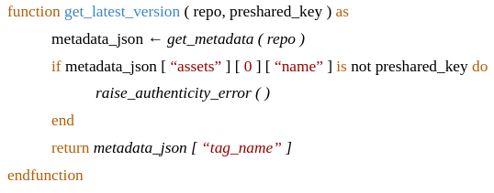
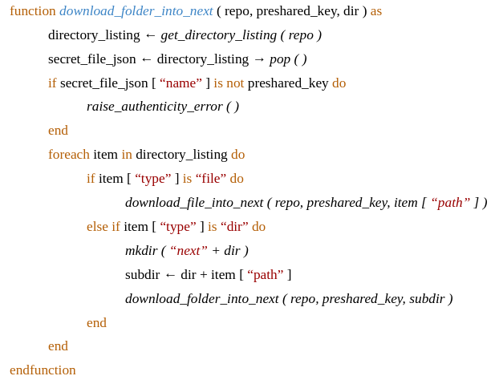
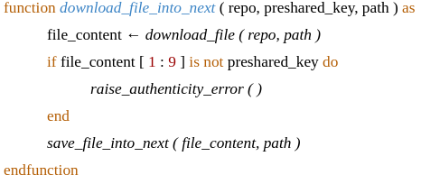
Security Updatability (FOTA)
The Github remote repository is put under private access
Securing the content on the repository is left to Github
When content is downloaded to esp32
TLS encryption guarantees confidentiality
Need to guarantee authenticity
There are 2 methods to verify the authenticity of download content
Verify the authenticity of the server by CA verification (transport-level authentication)
Application-level authentication
CA verification was not applicable here
Memory limitation
Only supports TLS certificates generated from RSA of size 2048 down
An ad-hoc application-level authentication method
Maintaining a pre-shared key with remote repository owner
The owner embeds the pre-shared key into every content that is to be download

Slide 26
Safety Updatability (FOTA)
Ensure the integrity of the downloaded content
Integrity is at risk when connection is lost mid-download
The HTTP function would poll forever
The empty socket class can still be read without raising any error
Exception could not be caught for processing
Solution
Function call timeout
No normal MicroPython construct to set timeout on a function call
Timeout is only available through multithreading or multiprocessing modules
Built-in multithreading library asyncio
Race-condition free at every level
Guaranteed atomicity

Slide 27
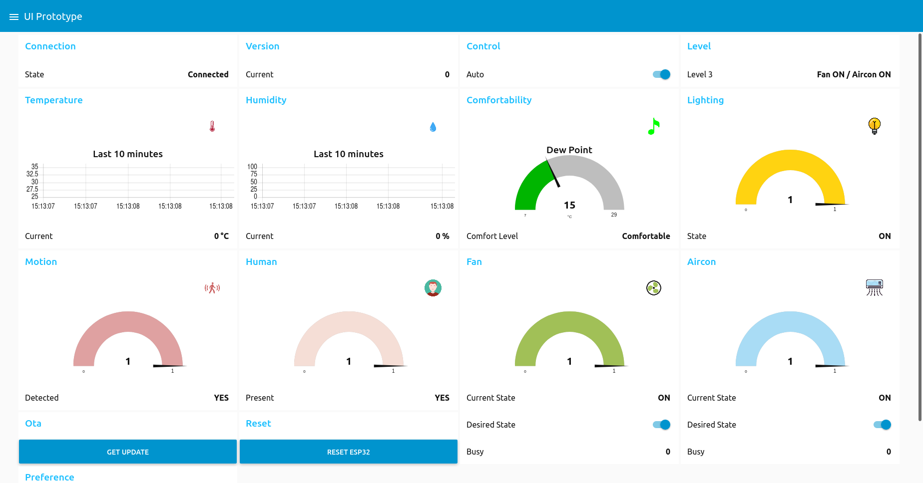
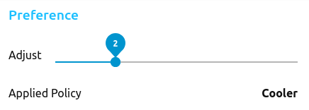
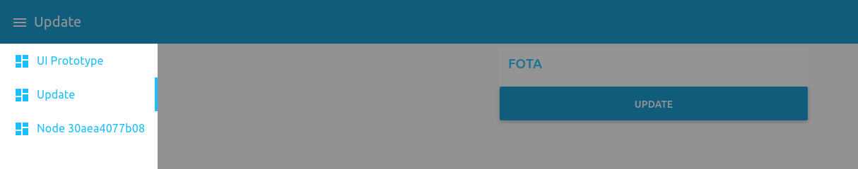
Web UI
Preference menu
FOTA update menu

Slide 28




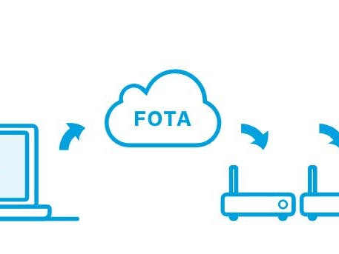
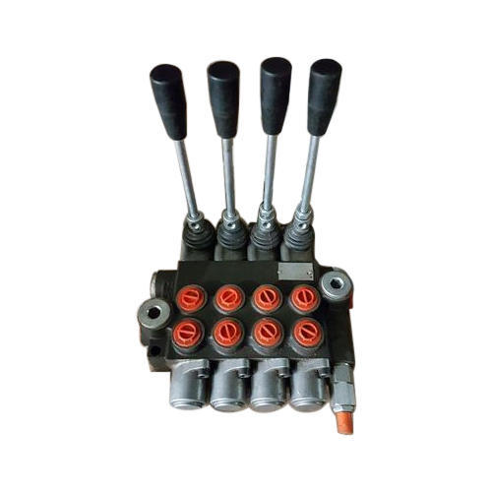





Result Summary
x N
Auto
Monitor
Manual
Hot
Good
7
Cold

Slide 29
Limitations Summary
IoT limitations
Only work with ON/OFF command
Basic sensors can differentiate between complex fan or AC state
The AC remote is a complex FSM
Automation rules limitations
Handcrafted based on common and heuristic logic
No machine learning
Scalability limitation
Design for dynamic scalability of sensor/actuator node
Design for scalability of controller node is beyond this scope
Remote access limitations
Could be inconvenient through small mobile screens
VPN was not applicable
Updatability (FOTA) limitations
File has to be buffered in RAM first for authenticity test
The maximum file size that can be download is about 45 KB
If not buffered and saved to file immediately, the maximum size is at least 1 MB
RAM limitation
FOTA update is only performed at boot, before IoT service is started
Can not hold both the IoT service and update process at the same time
User has to reset to perform update
Usability limitations
Different esp32 have to be distinguished by forgettable unique machine ID
Other limitations
The LAN setup process has some side effects
Can not mount RPi file system on another PC anymore, though the other direction is still possible
The taskbar network icon on Raspberry Pi OS is corrupted afterwards

Slide 30


